Slide 1
The list of cramming modules

Slide 2
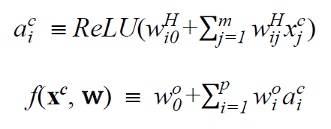
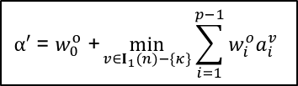


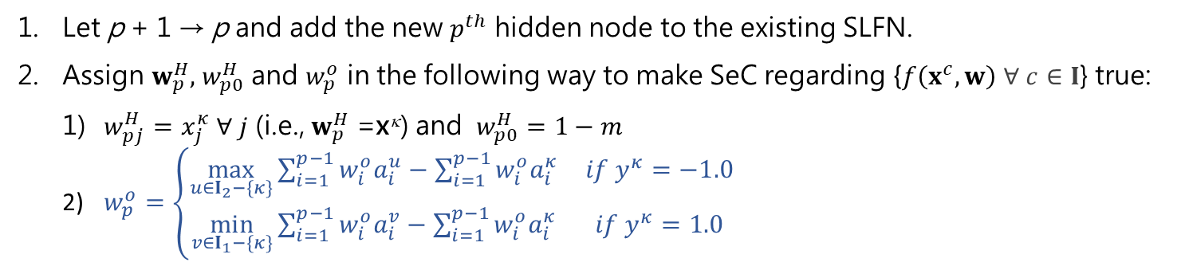

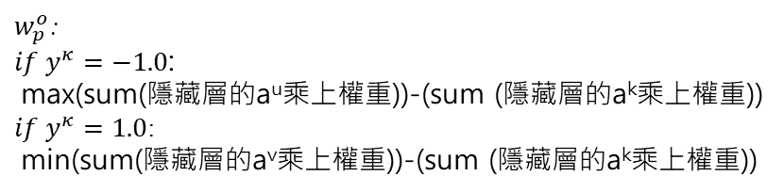
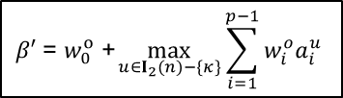

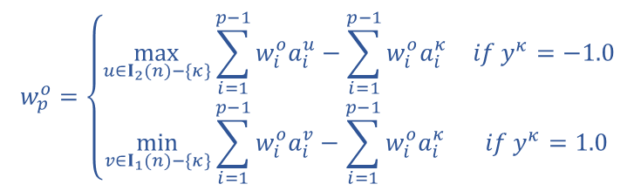
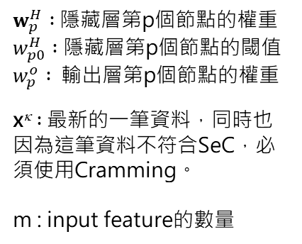

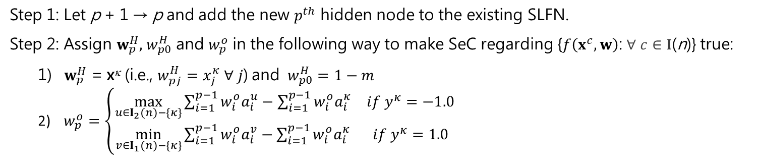
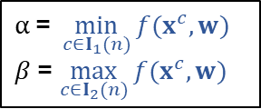
The cramming module (bi-ReLU-sbo)
classification problems
$w_{p}^{H} :$隱藏層第p個節點的權重
$w_{p0}^{H} :$隱藏層第p個節點的閾值
$w_{p}^{o} :$ 輸出層第p個節點的權重
x^{κ} $:$最新的一筆資料，同時也因為這筆資料不符合SeC，必須使用Cramming。
m : input feature的數量
Step 1: Let p + 1 → p and add the new $p^{th}$ hidden node to the existing SLFN.
Step 2: Assign $w_{p}^{H},$ $w_{p0}^{H}$ and $w_{p}^{o}$ in the following way to make SeC regarding {$f\left(x^{c},w\right)$: $∀ c∈I$(n)} true:
$w_{p}^{H}$ = x^{κ} (i.e., $w_{pj}^{H}=x_{j}^{κ}$ $∀ j$) and $w_{p0}^{H}=1−m$
$w_{p}^{o}=\left\{\begin{matrix}\max_{u∈I_{2}(n)−\{κ\}}{\sum_{i=1}^{p−1}{w_{i}^{o}a_{i}^{u}−\sum_{i=1}^{p−1}{w_{i}^{o}a_{i}^{κ}}}} & if{ y}^{κ}=−1.0 \\ \min_{v∈I_{1}(n)−\{κ\}}{\sum_{i=1}^{p−1}{w_{i}^{o}a_{i}^{v}}}−\sum_{i=1}^{p−1}{w_{i}^{o}a_{i}^{κ}} & if{ y}^{κ}=1.0\end{matrix}\right.$
$f_{old}\left(x^{κ},w\right)$= $w_{0}^{o}$ + $\sum_{i=1}^{p−1}{w_{i}^{o}a_{i}^{κ}}$
$$w_{p}^{o}=\left\{\begin{matrix}\max_{u∈I_{2}(n)−\{κ\}}{\sum_{i=1}^{p−1}{w_{i}^{o}a_{i}^{u}−\sum_{i=1}^{p−1}{w_{i}^{o}a_{i}^{κ}}}} & if{ y}^{κ}=−1.0 \\ \min_{v∈I_{1}(n)−\{κ\}}{\sum_{i=1}^{p−1}{w_{i}^{o}a_{i}^{v}}}−\sum_{i=1}^{p−1}{w_{i}^{o}a_{i}^{κ}} & if{ y}^{κ}=1.0\end{matrix}\right.$$
$$β′ \text{=} w_{0}^{o} \text{+}\max_{u∈I_{2}(n)−\{κ\}}{\sum_{i=1}^{p−1}{w_{i}^{o}a_{i}^{u}}}$$
1
$$α′ \text{=} w_{0}^{o} \text{+}\min_{v∈I_{1}(n)−\{κ\}}{\sum_{i=1}^{p−1}{w_{i}^{o}a_{i}^{v}}}$$
1
2
3
p
$w_{p0}^{H}$ = $1−m$
…
$w_{p}^{o}$:
$if{ y}^{κ}=−1.0$:
max(sum(隱藏層的a^{u}乘上權重))-(sum (隱藏層的a^{k}乘上權重))
$if{ y}^{κ}=1.0$:
min(sum(隱藏層的a^{v}乘上權重))-(sum (隱藏層的a^{k}乘上權重))
$w_{pj }^{H}$= $x_{j}^{κ}$ $∀ j$
1
2
……
m
$$β$$
$$α$$
$$α \text{=} \min_{c∈I_{1}(n)}{f(x^{c},w)}$$
$β$= $\max_{c∈I_{2}(n)}{f(x^{c},w)}$
learning goal type III: SeC
o
o
o
x
x
o
x
x
$$f\left(x^{c},w\right)$$
Notes:
此處仍看不出來tau的意義

Slide 3
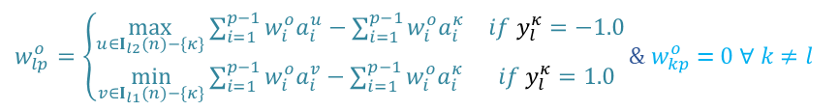

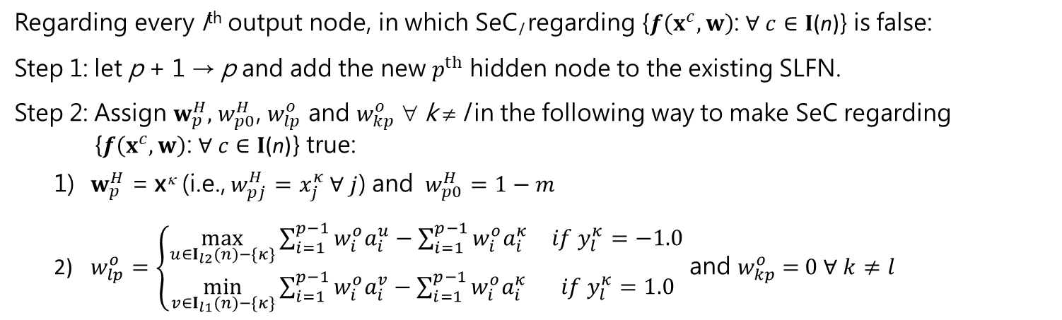

The cramming module (bi-ReLU-mbo)
classification problems
Regarding every l^{th} output node, in which SeC_{l} regarding {$f\left(x^{c},w\right)$: $∀ c∈I\text{(}\text{n}\text{)}$} is false:
Step 1: let p + 1 → p and add the new $p^{th}$ hidden node to the existing SLFN.
Step 2: Assign $w_{p}^{H},$ $w_{p0}^{H}$, $w_{lp}^{o}$ and $w_{kp}^{o}$ ∀ k ≠ l in the following way to make SeC regarding {$f\left(x^{c},w\right)$: $∀ c∈I\text{(}\text{n}\text{)}$} true:
$w_{p}^{H}$ = x^{κ} (i.e., $w_{pj}^{H}=x_{j}^{κ}$ $∀ j$) and $w_{p0}^{H}=1−m$
$w_{lp}^{o}=\left\{\begin{matrix}\max_{u∈I_{l2}(n)−\{κ\}}{\sum_{i=1}^{p−1}{w_{i}^{o}a_{i}^{u}−\sum_{i=1}^{p−1}{w_{i}^{o}a_{i}^{κ}}}} & if y_{l}^{κ}=−1.0 \\ \min_{v∈I_{l1}(n)−\{κ\}}{\sum_{i=1}^{p−1}{w_{i}^{o}a_{i}^{v}}}−\sum_{i=1}^{p−1}{w_{i}^{o}a_{i}^{κ}} & if y_{l}^{κ}=1.0\end{matrix}\right.$ and $w_{kp}^{o}$ = $0 ∀ k≠l$
1
…
l
…
q
$w_{lp}^{o}=\left\{\begin{matrix}\max_{u∈I_{l2}(n)−\{κ\}}{\sum_{i=1}^{p−1}{w_{i}^{o}a_{i}^{u}−\sum_{i=1}^{p−1}{w_{i}^{o}a_{i}^{κ}}}} & if y_{l}^{κ}=−1.0 \\ \min_{v∈I_{l1}(n)−\{κ\}}{\sum_{i=1}^{p−1}{w_{i}^{o}a_{i}^{v}}}−\sum_{i=1}^{p−1}{w_{i}^{o}a_{i}^{κ}} & if{ y}_{l}^{κ}=1.0\end{matrix}\right.$ & $w_{kp}^{o}$ = $0 ∀ k≠l$
1
2
3
…
p
$w_{p0}^{H}$ = $1−m$
$w_{pj }^{H}$= $x_{j}^{κ}$ $∀ j$
1
2
……
m

Slide 4



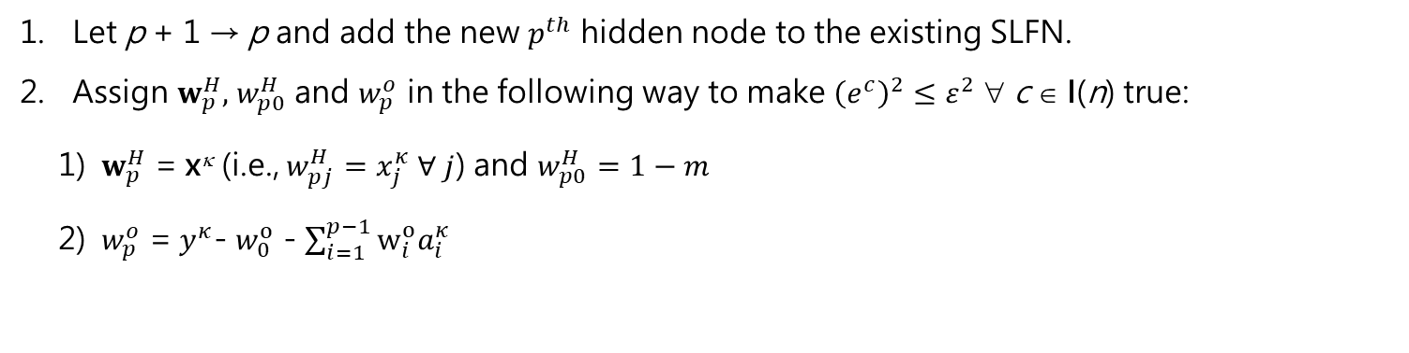
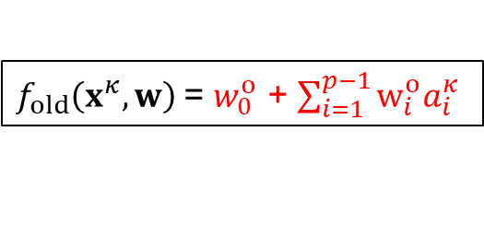

The cramming module (bi-ReLU-sro)
regression problems
$$\text{e}\text{c} \text{≡ }\text{f}\text{(}\text{x}\text{c}\text{,} \text{w}\text{)}\text{ − }\text{y}\text{c}$$
Let p + 1 → p and add the new $p^{th}$ hidden node to the existing SLFN.
Assign $w_{p}^{H},$ $w_{p0}^{H}$ and $w_{p}^{o}$ in the following way to make ${\left(e^{c}\right)}^{2}≤ε^{2}$ ∀ c ∈ I(n) true:
${ w}_{p}^{H}$ = x^{κ} (i.e., $w_{pj}^{H}=x_{j}^{κ}$ $∀ j$) and $w_{p0}^{H}=1−m$
${ w}_{p}^{o}$ = $y^{κ}$- $w_{0}^{o}$ - $\sum_{i=1}^{p−1}{w_{i}^{o}a_{i}^{κ}}$
1
$f_{old}\left(x^{κ},w\right)$= $w_{0}^{o}$ + $\sum_{i=1}^{p−1}{w_{i}^{o}a_{i}^{κ}}$
$$w_{p}^{o}={y^{κ}−f}_{old}\left(x^{κ},w\right)$$
1
2
3
…
p
$w_{p0}^{H}$ = $1−m$
$w_{pj }^{H}$= $x_{j}^{κ}$ $∀ j$
1
2
……
m

Slide 5
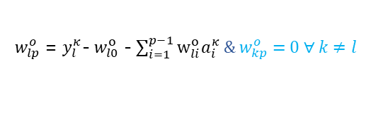

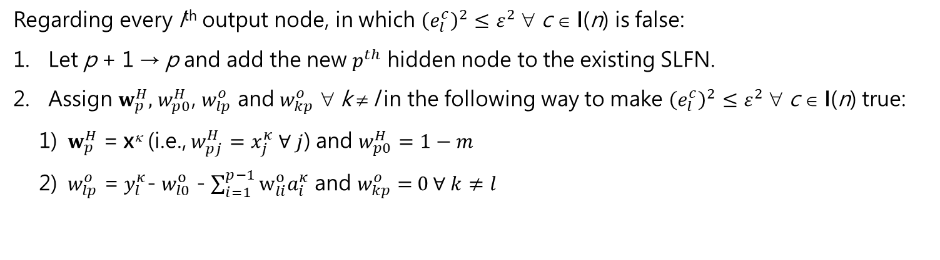
The cramming module (bi-ReLU-mro)
regression problems
$$e_{l}^{c}\text{≡} \text{f}\text{(}\text{x}\text{c}\text{,}w_{l0}^{o}\text{,}w_{l}^{o}\text{, }w_{0}^{H}\text{, }\text{W}\text{H}\text{)}\text{−}y_{l}^{c}$$
Regarding every l^{th} output node, in which ${\left(e_{l}^{c}\right)}^{2}≤ε^{2}$ ∀ c ∈ I(n) is false:
Let p + 1 → p and add the new $p^{th}$ hidden node to the existing SLFN.
Assign $w_{p}^{H},$ $w_{p0}^{H}$, $w_{lp}^{o}$ and $w_{kp}^{o}$ ∀ k ≠ l in the following way to make ${\left(e_{l}^{c}\right)}^{2}≤ε^{2}$ ∀ c ∈ I(n) true:
${ w}_{p}^{H}$ = x^{κ} (i.e., $w_{pj}^{H}=x_{j}^{κ}$ $∀ j$) and $w_{p0}^{H}=1−m$
${ w}_{lp}^{o}$ = $y_{l}^{κ}$- $w_{l0}^{o}$ - $\sum_{i=1}^{p−1}{w_{li}^{o}a_{i}^{κ}}$ and $w_{kp}^{o}$ = $0 ∀ k≠l$
1
…
l
…
q
${ w}_{lp}^{o}$ = $y_{l}^{κ}$- $w_{l0}^{o}$ - $\sum_{i=1}^{p−1}{w_{li}^{o}a_{i}^{κ}}$ & $w_{kp}^{o}$ = $0 ∀ k≠l$
1
2
3
…
p
$w_{p0}^{H}$ = $1−m$
$w_{pj }^{H}$= $x_{j}^{κ}$ $∀ j$
1
2
……
m

Slide 6
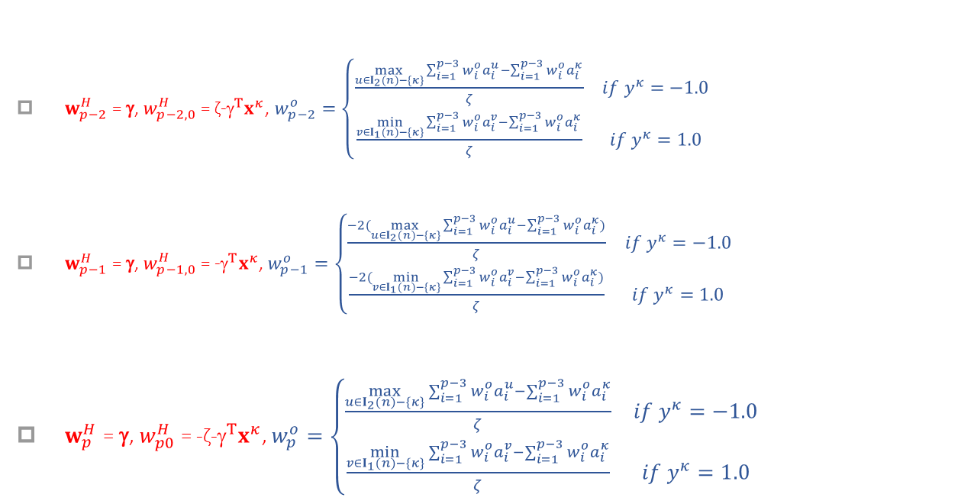
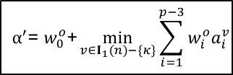
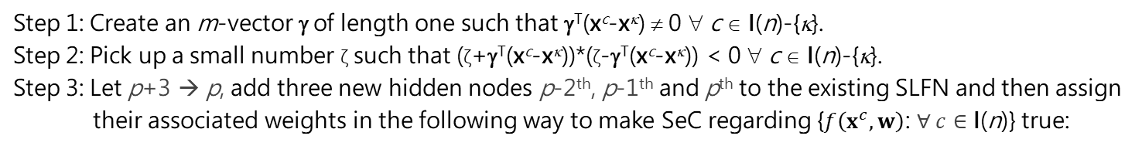
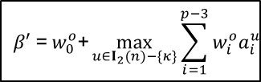

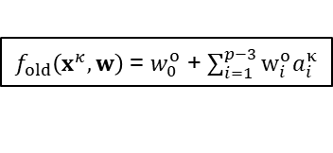
The cramming module (ri-ReLU-sbo)
classification problems
Step 1: Create an m-vector γ of length one such that γ^{T}(x^{c}-x^{κ}) ≠ 0 ∀ c ∈ I(n)-{κ}.
Step 2: Pick up a small number ζ such that (ζ+γ^{T}(x^{c}-x^{κ}))*(ζ-γ^{T}(x^{c}-x^{κ})) < 0 ∀ c ∈ I(n)-{κ}.
Step 3: Let p+3 → p, add three new hidden nodes p-2th, p-1th and p^{th} to the existing SLFN and then assign their associated weights in the following way to make SeC regarding {$f\left(x^{c},w\right)$: $∀ c∈\text{I}\text{(}\text{n}\text{)}$} true:
$w_{p−2}^{H}$ = γ, $w_{p−2,0}^{H}$ = ζ-$^{T}x^{κ}$, $w_{p−2}^{o}=\left\{\begin{matrix}\frac{\max_{u∈I_{2}(n)−\{κ\}}{\sum_{i=1}^{p−3}{w_{i}^{o}a_{i}^{u}−\sum_{i=1}^{p−3}{w_{i}^{o}a_{i}^{κ}}}}}{ζ} & if{ y}^{κ}=−1.0 \\ \frac{\min_{v∈I_{1}(n)−\{κ\}}{\sum_{i=1}^{p−3}{w_{i}^{o}a_{i}^{v}}}−\sum_{i=1}^{p−3}{w_{i}^{o}a_{i}^{κ}}}{ζ} & if{ y}^{κ}=1.0\end{matrix}\right.$
$w_{p−1}^{H}$ = γ, $w_{p−1,0}^{H}$ = -$^{T}x^{κ}$, $w_{p−1}^{o}=\left\{\begin{matrix}\frac{−2(\max_{u∈I_{2}(n)−\{κ\}}{\sum_{i=1}^{p−3}{w_{i}^{o}a_{i}^{u}−\sum_{i=1}^{p−3}{w_{i}^{o}a_{i}^{κ})}}}}{ζ} & if{ y}^{κ}=−1.0 \\ \frac{−2(\min_{v∈I_{1}(n)−\{κ\}}{\sum_{i=1}^{p−3}{w_{i}^{o}a_{i}^{v}}}−\sum_{i=1}^{p−3}{w_{i}^{o}a_{i}^{κ})}}{ζ} & if{ y}^{κ}=1.0\end{matrix}\right.$
$w_{p}^{H}$ = γ, $w_{p0}^{H}$ = -ζ-$^{T}x^{κ}$, $w_{p}^{o}=\left\{\begin{matrix}\frac{\max_{u∈I_{2}(n)−\{κ\}}{\sum_{i=1}^{p−3}{w_{i}^{o}a_{i}^{u}−\sum_{i=1}^{p−3}{w_{i}^{o}a_{i}^{κ}}}}}{ζ} & if{ y}^{κ}=−1.0 \\ \frac{\min_{v∈I_{1}(n)−\{κ\}}{\sum_{i=1}^{p−3}{w_{i}^{o}a_{i}^{v}}}−\sum_{i=1}^{p−3}{w_{i}^{o}a_{i}^{κ}}}{ζ} & if{ y}^{κ}=1.0\end{matrix}\right.$
$$α^{′}\text{= }w_{0}^{o}\text{+}\min_{v∈I_{1}(n)−\{κ\}}{\sum_{i=1}^{p−3}{w_{i}^{o}a_{i}^{v}}}$$
$$β′ \text{=}{ w}_{0}^{o}\text{+}\max_{u∈I_{2}(n)−\{κ\}}{\sum_{i=1}^{p−3}{w_{i}^{o}a_{i}^{u}}}$$
$f_{old}\left(x^{κ},w\right)$= $w_{0}^{o}$ + $\sum_{i=1}^{p−3}{w_{i}^{o}a_{i}^{κ}}$
$∆f$= ${ζw}_{p}^{o}$
6

Slide 7
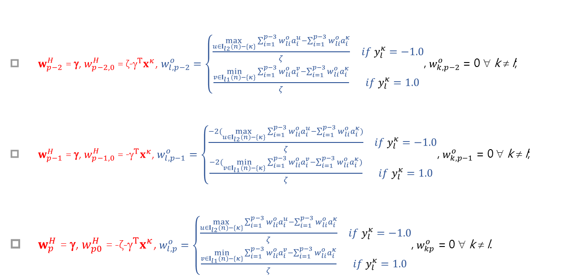
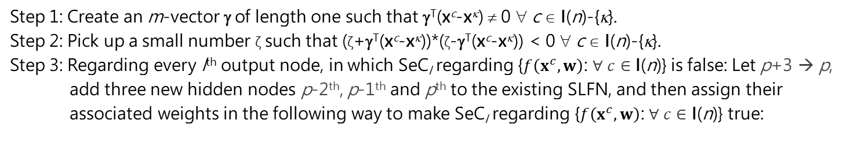
The cramming module (ri-ReLU-mbo)
classification problems
Step 1: Create an m-vector γ of length one such that γ^{T}(x^{c}-x^{κ}) ≠ 0 ∀ c ∈ I(n)-{κ}.
Step 2: Pick up a small number ζ such that (ζ+γ^{T}(x^{c}-x^{κ}))*(ζ-γ^{T}(x^{c}-x^{κ})) < 0 ∀ c ∈ I(n)-{κ}.
Step 3: Regarding every l^{th} output node, in which SeC_{l} regarding {$f\left(x^{c},w\right)$: $∀ c∈\text{I}\text{(}\text{n}\text{)}$} is false: Let p+3 → p, add three new hidden nodes p-2th, p-1th and p^{th} to the existing SLFN, and then assign their associated weights in the following way to make SeC_{l} regarding {$f\left(x^{c},w\right)$: $∀ c∈\text{I}\text{(}\text{n}\text{)}$} true:
$w_{p−2}^{H}$ = γ, $w_{p−2,0}^{H}$ = ζ-$^{T}x^{κ}$, $w_{l,p−2}^{o}=\left\{\begin{matrix}\frac{\max_{u∈I_{l2}(n)−\{κ\}}{\sum_{i=1}^{p−3}{w_{li}^{o}a_{i}^{u}−\sum_{i=1}^{p−3}{w_{li}^{o}a_{i}^{κ}}}}}{ζ} & if y_{l}^{κ}=−1.0 \\ \frac{\min_{v∈I_{l1}(n)−\{κ\}}{\sum_{i=1}^{p−3}{w_{li}^{o}a_{i}^{v}}}−\sum_{i=1}^{p−3}{w_{li}^{o}a_{i}^{κ}}}{ζ} & if{ y}_{l}^{κ}=1.0\end{matrix}\right.$, $w_{k,p−2}^{o}$ = 0 ∀ k ≠ l;
$w_{p−1}^{H}$ = γ, $w_{p−1,0}^{H}$ = -$^{T}x^{κ}$, $w_{l,p−1}^{o}=\left\{\begin{matrix}\frac{−2(\max_{u∈I_{l2}(n)−\{κ\}}{\sum_{i=1}^{p−3}{w_{li}^{o}a_{i}^{u}−\sum_{i=1}^{p−3}{w_{li}^{o}a_{i}^{κ})}}}}{ζ} & if y_{l}^{κ}=−1.0 \\ \frac{−2(\min_{v∈I_{l1}(n)−\{κ\}}{\sum_{i=1}^{p−3}{w_{li}^{o}a_{i}^{v}}}−\sum_{i=1}^{p−3}{w_{li}^{o}a_{i}^{κ})}}{ζ} & if y_{l}^{κ}=1.0\end{matrix}\right.$, $w_{k,p−1}^{o}$ = 0 ∀ k ≠ l;
$w_{p}^{H}$ = γ, $w_{p0}^{H}$ = -ζ-$^{T}x^{κ}$, $w_{l,p}^{o}=\left\{\begin{matrix}\frac{\max_{u∈I_{l2}(n)−\{κ\}}{\sum_{i=1}^{p−3}{w_{li}^{o}a_{i}^{u}−\sum_{i=1}^{p−3}{w_{li}^{o}a_{i}^{κ}}}}}{ζ} & if{ y}_{l}^{κ}=−1.0 \\ \frac{\min_{v∈I_{l1}(n)−\{κ\}}{\sum_{i=1}^{p−3}{w_{li}^{o}a_{i}^{v}}}−\sum_{i=1}^{p−3}{w_{li}^{o}a_{i}^{κ}}}{ζ} & if y_{l}^{κ}=1.0\end{matrix}\right.$, $w_{kp}^{o}$ = 0 ∀ k ≠ l.
7

Slide 8
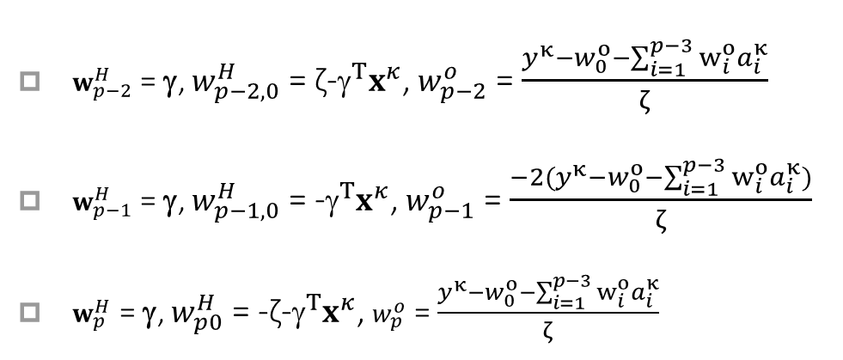
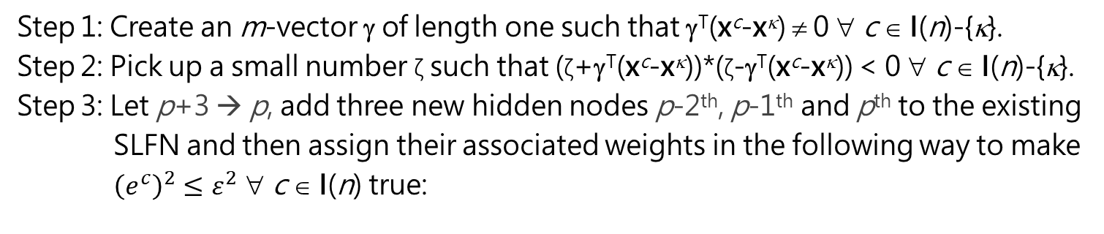
The cramming module (ri-ReLU-sro)
regression problems
$$\text{e}\text{c} \text{≡ }\text{f}\text{(}\text{x}\text{c}\text{,} \text{w}\text{)}\text{ − }\text{y}\text{c}$$
Step 1: Create an m-vector γ of length one such that γ^{T}(x^{c}-x^{κ}) ≠ 0 ∀ c ∈ I(n)-{κ}.
Step 2: Pick up a small number ζ such that (ζ+γ^{T}(x^{c}-x^{κ}))*(ζ-γ^{T}(x^{c}-x^{κ})) < 0 ∀ c ∈ I(n)-{κ}.
Step 3: Let p+3 → p, add three new hidden nodes p-2th, p-1th and p^{th} to the existing SLFN and then assign their associated weights in the following way to make ${\left(e^{c}\right)}^{2}≤ε^{2}$ ∀ c ∈ I(n) true:
$w_{p−2}^{H}$ = γ, $w_{p−2,0}^{H}$ = ζ-$^{T}x^{κ}$, $w_{p−2}^{o}$ = $\frac{y^{κ}−w_{0}^{o}−\sum_{i=1}^{p−3}{w_{i}^{o}a_{i}^{κ}}}{ζ}$
$w_{p−1}^{H}$ = γ, $w_{p−1,0}^{H}$ = -$^{T}x^{κ}$, $w_{p−1}^{o}$ = $\frac{{−2(y}^{κ}−w_{0}^{o}−\sum_{i=1}^{p−3}{w_{i}^{o}a_{i}^{κ})}}{ζ}$
$w_{p}^{H}$ = γ, $w_{p0}^{H}$ = -ζ-$^{T}x^{κ}$, $w_{p}^{o}$ = $\frac{y^{κ}−w_{0}^{o}−\sum_{i=1}^{p−3}{w_{i}^{o}a_{i}^{κ}}}{ζ}$
8

Slide 9
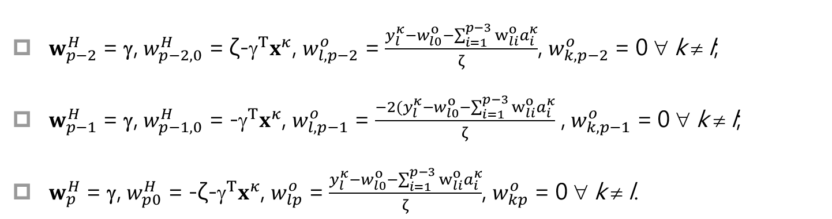
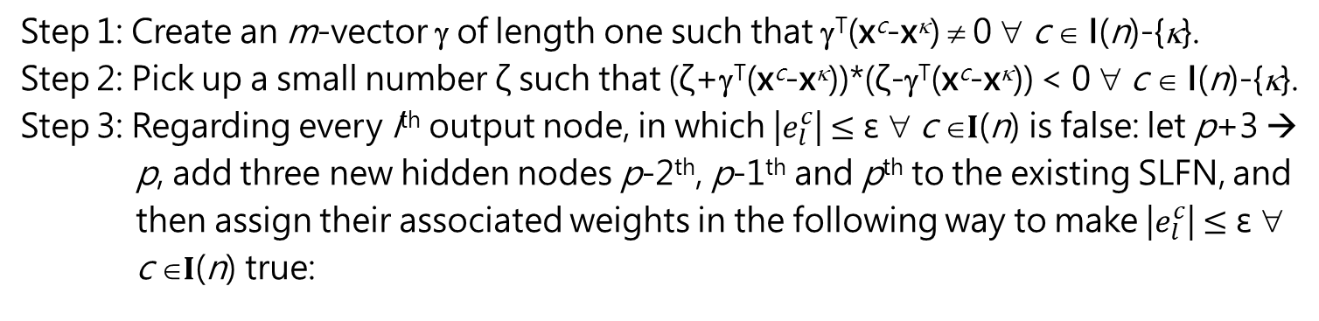
The cramming module (ri-ReLU-mro)
regression problems
$$e_{l}^{c}\text{≡} \text{f}\text{(}\text{x}\text{c}\text{,}w_{l0}^{o}\text{,}w_{l}^{o}\text{, }w_{0}^{H}\text{, }\text{W}\text{H}\text{)}\text{−}y_{l}^{c}$$
Step 1: Create an m-vector γ of length one such that γ^{T}(x^{c}-x^{κ}) ≠ 0 ∀ c ∈ I(n)-{κ}.
Step 2: Pick up a small number ζ such that (ζ+γ^{T}(x^{c}-x^{κ}))*(ζ-γ^{T}(x^{c}-x^{κ})) < 0 ∀ c ∈ I(n)-{κ}.
Step 3: Regarding every l^{th} output node, in which |$e_{l}^{c}$| $≤\text{ε}$ ∀ c ∈$I$(n) is false: let p+3 → p, add three new hidden nodes p-2th, p-1th and p^{th} to the existing SLFN, and then assign their associated weights in the following way to make |$e_{l}^{c}$| $≤\text{ε}$ ∀ c ∈$I$(n) true:
$w_{p−2}^{H}$ = γ, $w_{p−2,0}^{H}$ = ζ-$^{T}x^{κ}$, $w_{l,p−2}^{o}$ = $\frac{y_{l}^{κ}−w_{l0}^{o}−\sum_{i=1}^{p−3}{w_{li}^{o}a_{i}^{κ}}}{ζ}$, $w_{k,p−2}^{o}$ = 0 ∀ k ≠ l;
$w_{p−1}^{H}$ = γ, $w_{p−1,0}^{H}$ = -$^{T}x^{κ}$, $w_{l,p−1}^{o}$ = $\frac{−2(y_{l}^{κ}−w_{l0}^{o}−\sum_{i=1}^{p−3}{w_{li}^{o}a_{i}^{κ}}}{ζ}$ , $w_{k,p−1}^{o}$ = 0 ∀ k ≠ l;
$w_{p}^{H}$ = γ, $w_{p0}^{H}$ = -ζ-$^{T}x^{κ}$, $w_{lp}^{o}$ = $\frac{y_{l}^{κ}−w_{l0}^{o}−\sum_{i=1}^{p−3}{w_{li}^{o}a_{i}^{κ}}}{ζ}$, $w_{kp}^{o}$ = 0 ∀ k ≠ l.

Slide 10
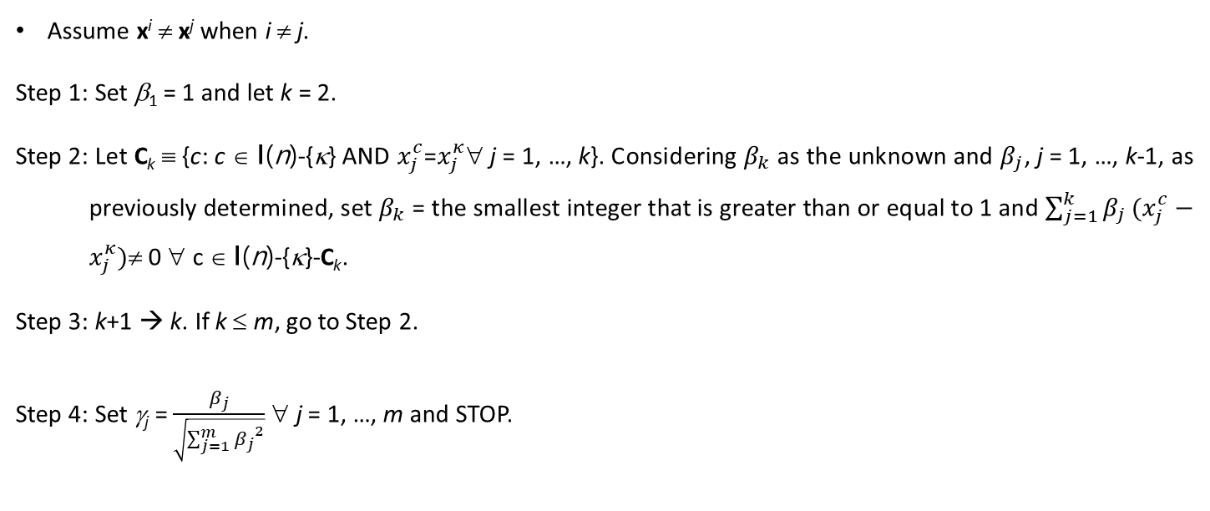
create an m-vector γ of length one such that γ^{T}(x^{c}-x^{κ}) ≠ 0 ∀ c ∈ I(n)-{κ}
Use the orientation algorithm to create an m-vector γ of length one such that γ^{T}(x^{c}-x^{κ}) ≠ 0 ∀ c ∈ I(n)-{κ}.
Assume x^{i} ≠ x^{j} when i ≠ j.
Step 1: Set β₁ = 1 and let k = 2.
Step 2: Let C_{k} ≡ {c: c ∈ I(n)-{κ} AND $x_{j}^{c}$=$x_{j}^{κ}$∀ j = 1, …, k}. Considering $β_{k}$ as the unknown and $β_{j}$, j = 1, …, k-1, as previously determined, set $β_{k}$ = the smallest integer that is greater than or equal to 1 and $\sum_{j=1}^{k}{β_{j}}(x_{j}^{c}−x_{j}^{κ})$≠ 0 ∀ c ∈ I(n)-{κ}-C_{k}.
Step 3: k+1 → k. If k ≤ m, go to Step 2.
Step 4: Set γ_{j} = $\frac{β_{j}}{\sqrt{\sum_{j=1}^{m}{{β_{j}}^{2}}}}$ ∀ j = 1, …, m and STOP.
10

Slide 11
create an m-vector γ of length one such that γ^{T}(x^{c}-x^{κ}) ≠ 0 ∀ c ∈ I(n)-{κ}
Use the random number method to create an m-vector γ of length one such that γ^{T}(x^{c}-x^{κ}) ≠ 0 ∀ c ∈ I(n)-{κ}.
11

Slide 12
Create an m-vector γ of length one and Pick up a small number ζ
Create an m-vector γ of length one such that γ^{T}(x^{c}-x^{κ}) ≠ 0 ∀ c ∈ I(n)-{κ}.
Pick up a small number ζ such that (ζ+γ^{T}(x^{c}-x^{κ}))*(ζ-γ^{T}(x^{c}-x^{κ})) < 0 ∀ c ∈ I(n)-{κ}.
Pick up a small number ζ and then use the random number method to create an m-vector γ of length one such that γ^{T}(x^{c}-x^{κ}) ≠ 0 ∀ c ∈ I(n)-{κ} AND (ζ+γ^{T}(x^{c}-x^{κ}))*(ζ-γ^{T}(x^{c}-x^{κ})) < 0 ∀ c ∈ I(n)-{κ}.
12

